Slide 1

Heterogeneous Graph Learning for NBA Game Outcome Prediction
Joseph Egan

Slide 2
Summary
Why this problem is interesting
Heterogeneous Graph Formulation
Heterogeneous Graph Attention Network Conv Layer
Architectures
Results
Next Steps/Further Research
Q&A

Slide 3
NBA Games as a Compelling Study
Sports are rich with data, NBA_API provides a variety of statistics on players and teams
Interactions between players, teams, and game strategies create intricate patterns
Graph structure not extensively studied in literature for game prediction
Statistically favored team doesn’t always win, frequent upsets
22% in the playoffs
32% in the regular season [1]
Best in class models predict with ~74% accuracy in playoffs, 68-72% in the regular season

Slide 4
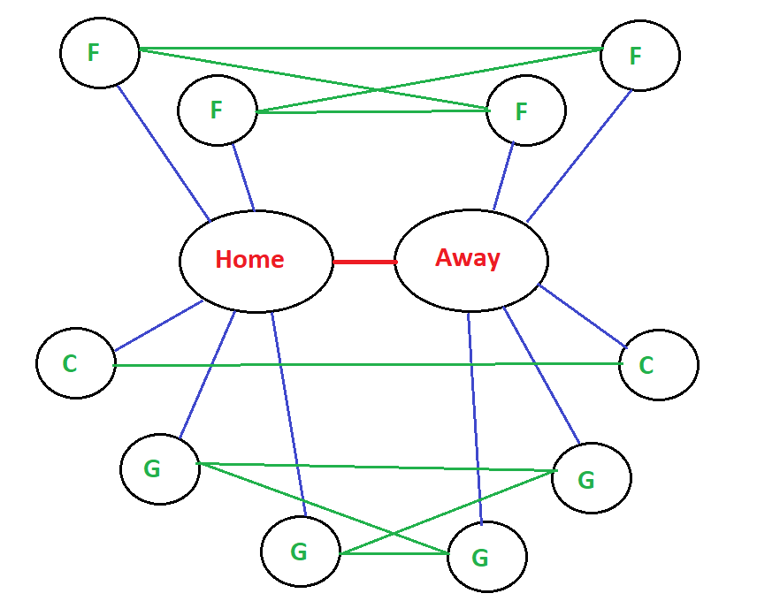
Representing a Game as a Heterogeneous Graph
This dataset did not exist
Aggregation of historical team and player single game statistics
Nodes: Teams and Players
Edges: Team-Team, Team-Player, Player-Player
Features: Teams, Players, Team-Team edge

Slide 5
Heterogeneous Graph Attention Network (HANConv)
HANConv: A Heterogeneous Graph Attention Layer
Adapts Graph Attention Mechanism for Heterogeneous Graphs
Node-level and Semantic-level Attention
Meta-path-based Neighborhood Aggregation

Slide 6
Architectures and using non-GNN networks
Team-Team FNN
2116 params
Team-Team-Player-Player FNN
4324 params (Shared vs Split Pooling)
HeteroConv + TTPP
5644 params
HANConv + TTPP
6412 params
Training Speed
Complexity
Pooling, Edge Features, Concatenation, Batch Size, Hidden Dims, Scheduler

Slide 7
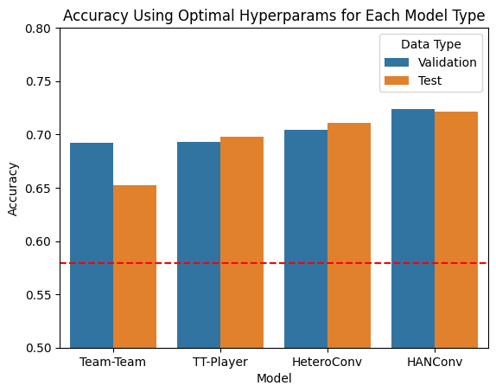
Training and results
7365 game graphs over 7 seasons
Grid/Random Search
Accuracies are very close
Possible there are better architectures

Slide 8
Observations and further study
Similarity in accuracy between graph and non-graph structure
More complex architectures require more optimization
Mixing Conv layers, HeteroConv layers/aggregations, pooling,
Vanishing gradients
Additional edge types and features
Additional node features
Studying attention weights over time

Slide 9
Q/a and thank you!
Joseph Egan

Slide 10
Citation
[1] Weiner, Josh. "Predicting the Outcome of NBA Games with Machine Learning." Towards Data Science, 5 Jan. 2021, https://towardsdatascience.com/predicting-the-outcome- of-nba-games-with-machine-learning-a810bb768f20

